Slide 1
EVENTS EXECUTOR

Slide 2
Motivations
We want to improve the performance of ROS 2 for embedded applications.
Target platform: single core 500MHz ARM32 processor (e.g. RPi 1).
Target system: high number of topics with 50-100Hz publish period.
Extensive analyses show that the executor is the main bottleneck in a ROS 2 system, so we designed and implemented the Events Executor.
The Events Executor is a rewrite from the ground-up of the standard executor. Reduce the performance gap between ROS 2 and functional APIs.

Slide 3
Principles
The Events Executor is based on the following principles.
You don't pay for what you don't use.
Minimal abstraction overhead between application and RMW.
Extensibility.
The principles are implemented through the following new components:
RMW Listener APIs (1, 2, 3)
Events Queue (1, 3)
Timers Manager (1)
Events Executor Entities Collector (1)

Slide 4
RMW Listener APIs
RMW Listener APIs are an alternative to DDS waitsets. The DDS spec supports them, but they were not exposed in ROS 2 yet.
These allow the application to register callbacks within ROS 2 entities. These callbacks will be invoked by the DDS layer whenever new data is received.
No need of expensive management of waitsets in each ROS 2 layer. Performance are not affected by entities that never have work to do.

Slide 5
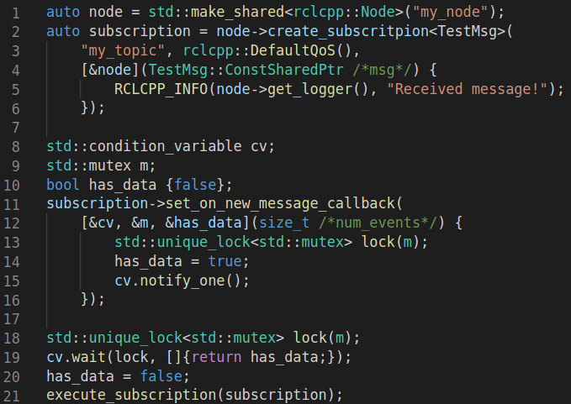
RMW Listener APIs
Define a function that triggers a condition variable.
Register it in a subscription using the new APIs.
Whenever a new message is received by the subscription, the DDS will execute the function.

Slide 6
Events Queue
Use RMW Listener APIs to push into an Events Queue owned by the Events Executor. Items will define which entity has work to do.
Define your custom Events Queue class just implementing the enqueue() and dequeue() functions.
Applications can define their own requirements (CPU, determinism, RAM, etc). Performance are not affected by entities that never have work to do. Events are automatically ordered according to when they have been received.

Slide 7
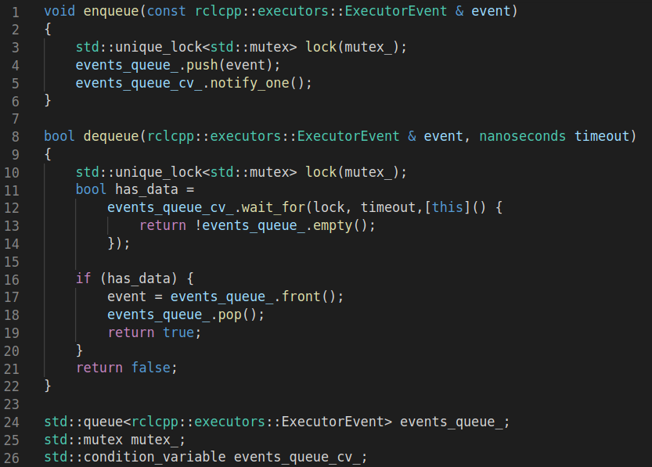
Events Queue
Possible Events Queue:
std::queue
Lock free queue
Bounded queue
Absolute-time-ordered queue
“Waitset queue”
…. And many more!

Slide 8
Timers Manager
RMW Listener APIs take care of ROS 2 entities (subscriptions, services, actions, waitables, etc). How to deal with timers?
The Timers Manager is a component owned by the Events Executor that takes care of executing timers. It’s a first step towards decoupling timers management from the rest of ROS 2 code. The OS can do it better than you!
No need to check all timers at every iteration of the executor.

Slide 9
Events Executor Entities Collector
The Events Executor Entities Collector is an adaptation of the Static Executor Entities Collector developed by iRobot for the Static Single Threaded Executor.
ROS 2 systems are mostly static in their steady state. The executor shouldn’t do extra work unless entities are being added or removed.
The Events Executor Entities Collector is a ROS 2 Waitable. Whenever an entity is added/removed it will take care of setting/unsetting the callback responsible for pushing events into the Events Queue.
Keep the fast path as fast as possible.

Slide 10
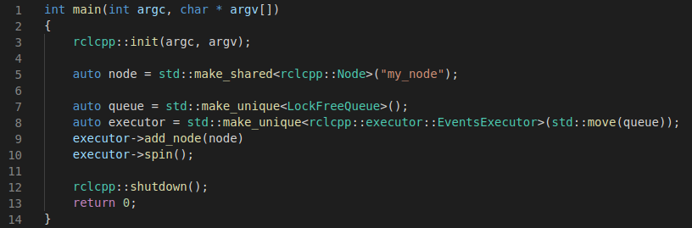
Using the Events Executor
The Events Executor supports all standard ROS 2 APIs. You can pass your custom Event Queues defined in your library.

Slide 11
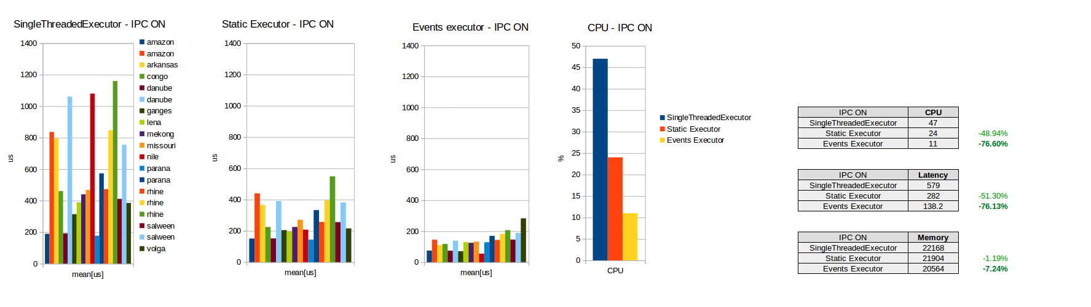
Events Executor CPU and Latency
Measured using https://github.com/irobot-ros/ros2-performance

Slide 12
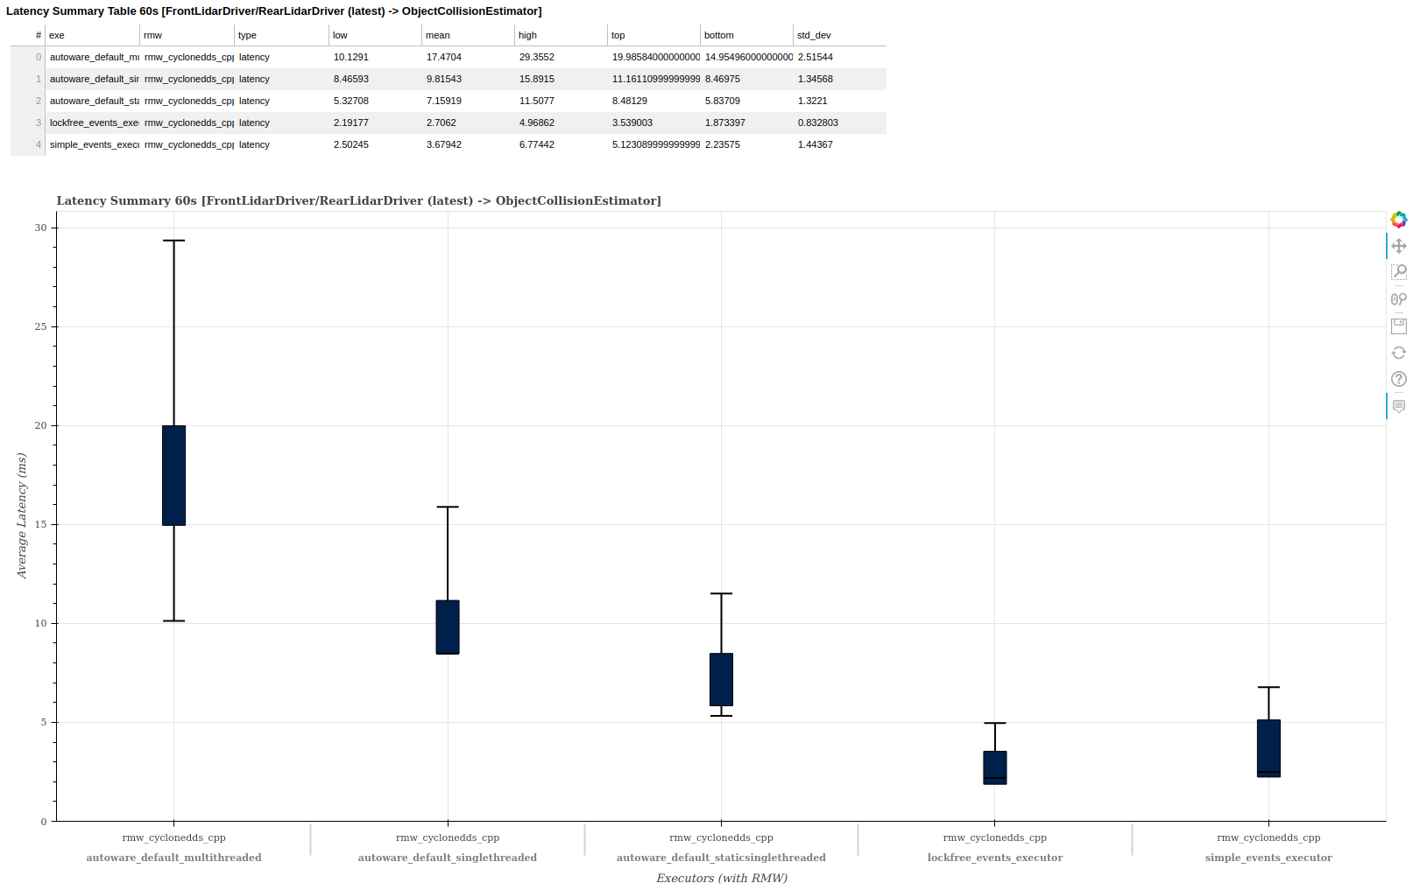
Reference System Latency

Slide 13
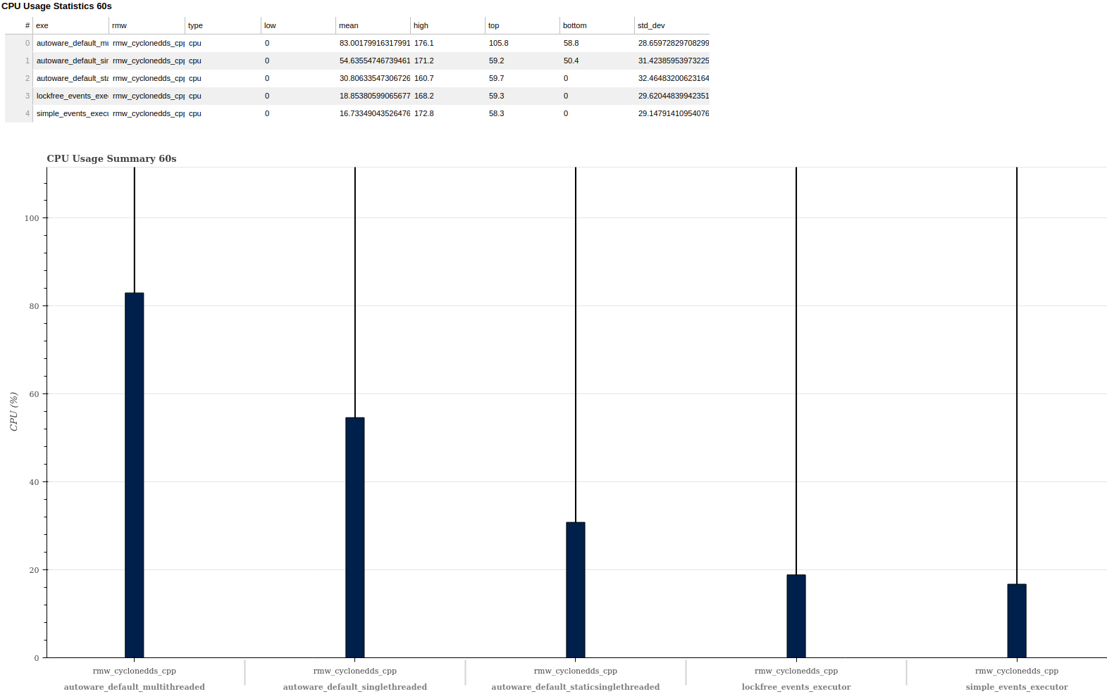
Reference System Performance

Slide 14
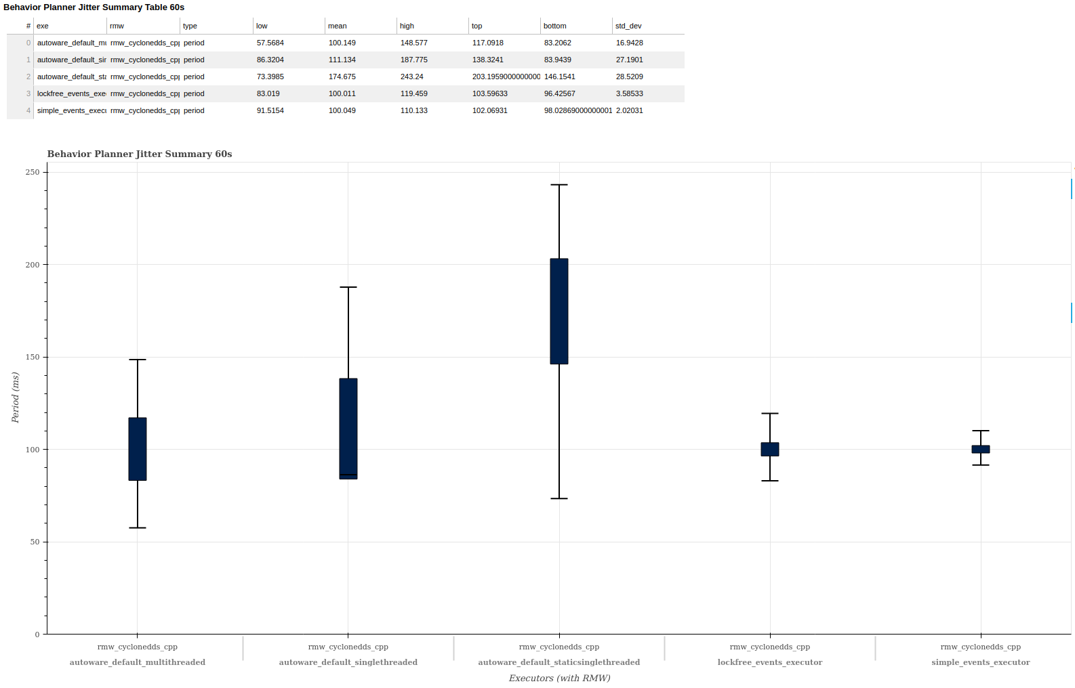
Reference System Performance

Slide 15
The Events Executor is open-source!
Events Executor Discourse introduction: https://discourse.ros.org/t/ros2-middleware-change-proposal/15863
Events Executor design PR: https://github.com/ros2/design/pull/305
RMW Listener APIs PR: https://github.com/ros2/rclcpp/pull/1579
Events Executor Galactic implementation:
https://github.com/irobot-ros/rclcpp/tree/galactic-events-executor
https://github.com/irobot-ros/rcl/tree/galactic-events-executor
https://github.com/irobot-ros/rmw/tree/galactic-events-executor
https://github.com/irobot-ros/rmw_implementation/tree/galactic-events-executor
https://github.com/irobot-ros/rmw_fastrtps/tree/galactic-events-executor
https://github.com/irobot-ros/rmw_cyclonedds/tree/galactic-events-executor

